Slide 1

In the age of Big Data, what role for Software Engineers?
tim.menzies@gmail.com lcsee, wvu, usa mar 2014

Slide 2
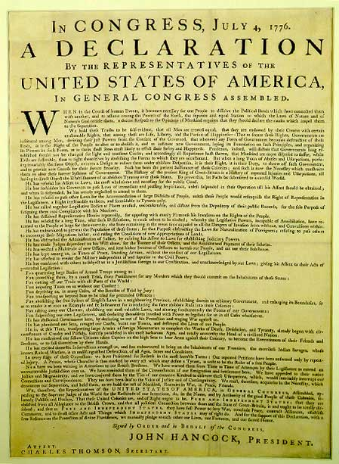

The Declaration of (Human) Dependence
We hold these truths to be self-evident….
Better conclusions =
more data
more cpu
human analysts finding better questions
automatic systems that better understand the questions

Slide 3
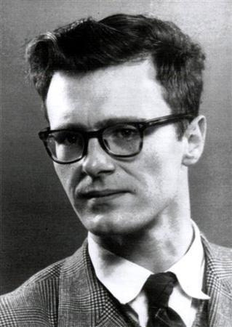

But not everyone agrees
Edsger Dijkstra, ICSE 4, 1979
“The notion of ‘user’ cannot be precisely defined, and therefore has no place in CS or SE.”
Anonymous machine learning researcher, 1986
“Kill all living human experts then resurrect the dead ones”

Slide 4
So what role for SE in the age of Big Data?
Analysis is a “systems” task?
Analysis is a “human” task?
The premise of Big Data:
better conclusions = same algorithms + more data + more cpu
If so, then …
No role for human analysts
All insight is auto-generated from CPUs.
Current results on “software analytics”
A human-intensive process

Slide 5
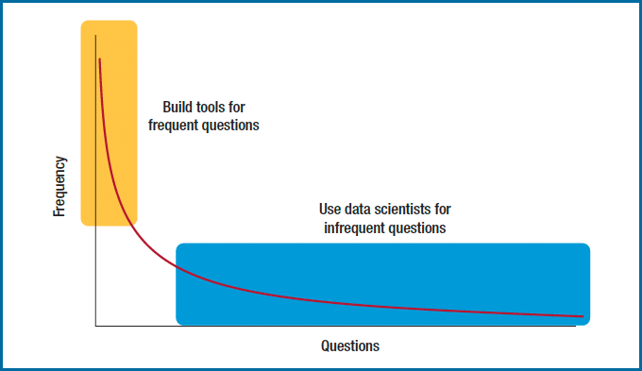
Q: Is Big Data a “Systems” or “Human”-task? A: Yes

Slide 6
This talk: in the age Big Data SE analysts are “goal engineers”
Search-based software engineering
CPU-intensive analysis
Taming the CPU crisis by understanding user goals
Algorithms needs goal-oriented requirements engineering
Goals are a primary design construct
To optimize, find the “landscape of the goals”
Goal-oriented RE need algorithms
Better tools for better explorations of user goals

Slide 7
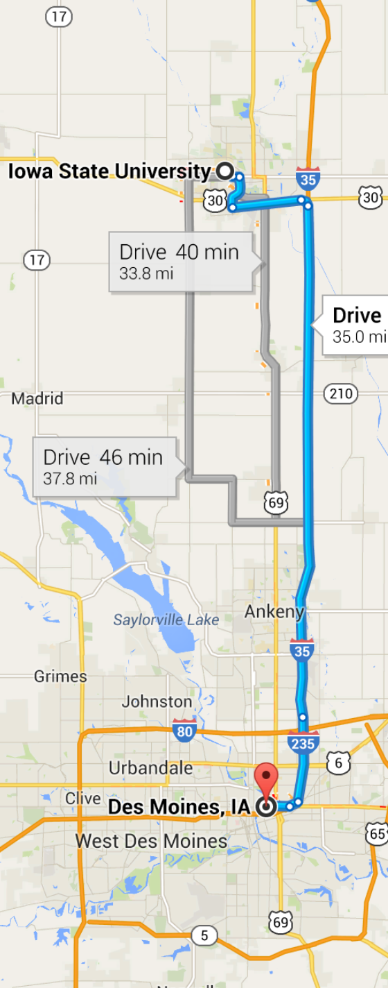
Road map
Define:
“CPU crisis”
“search-based software engineering”
“goal-oriented requirements engineering”
Why more tools? (not enough already)
The power of goal-oriented tools (IBEA)
Feature maps, product-line engineering
Next-gen goal-oriented tools (GALE)
Safety critical analysis cockpit software
Conclusions
Future work

Slide 8


Acknowledgements
SBSE + Feature Maps:
Abdel Sayyad Salem ,
WVU, current
GALE + air traffic control
Joe Krall
WVU, current

Slide 9
What is…
Goal-oriented requirements engineering?
The CPU crisis?
Search-based software engineering?

Slide 10
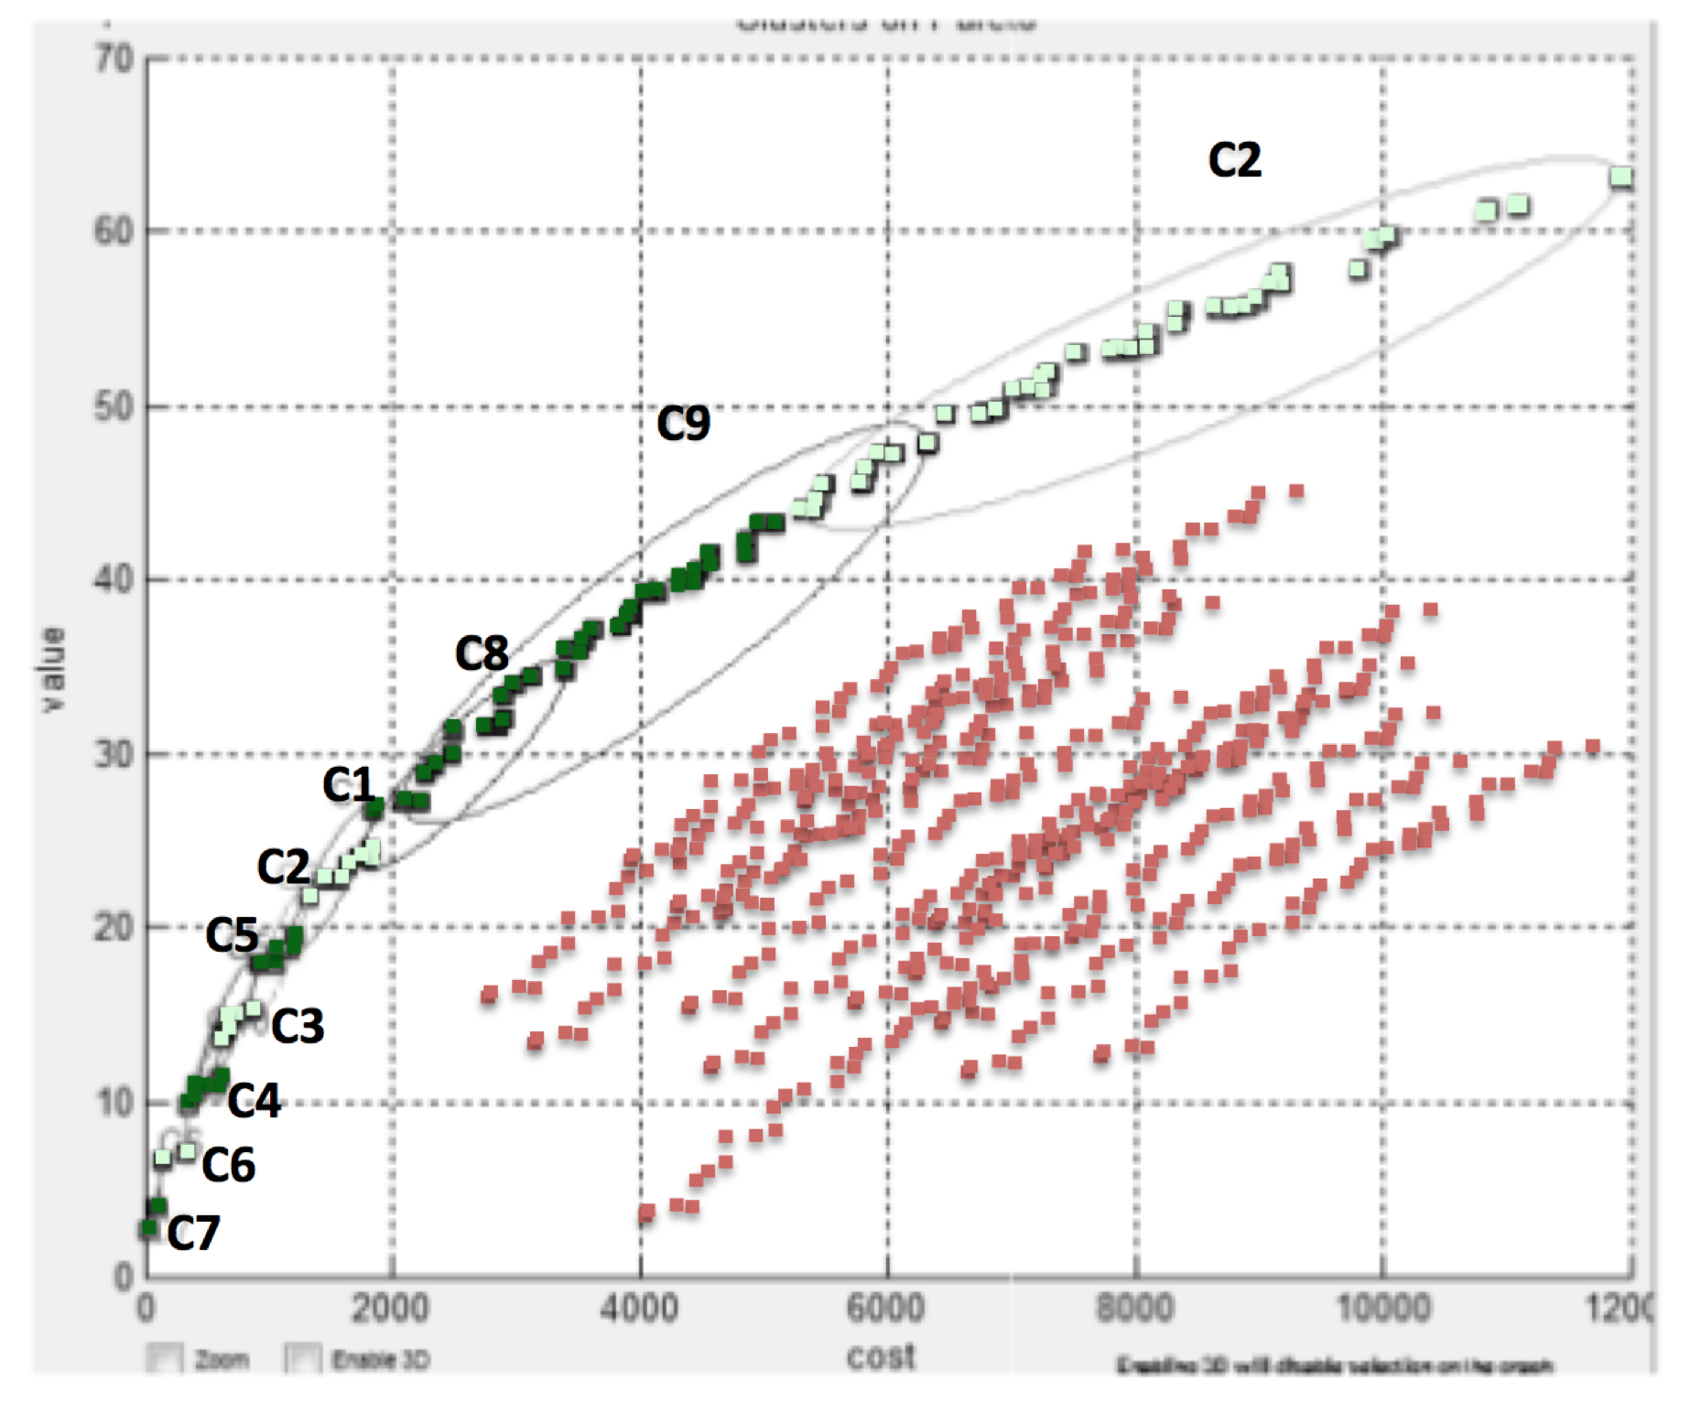
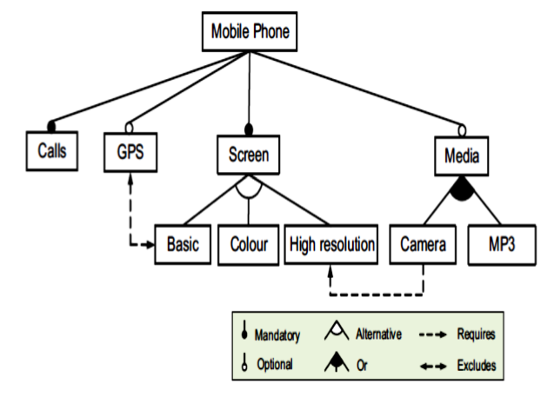
Goal-oriented RE
Axel van Lamsweerde: Goal-Oriented Requirements Engineering: A guides Tour [vanLam RE’01]
Goals capture objectives for the system.
Goal-oriented RE : using goals for eliciting, specifying, documenting, structuring, elaborating, analyzing, negotiating, modifying requirements.
Mostly
manual
✗
✗
Mostly
automatic
✗
✔
Notation- based e.g. UML
Search- based
SE
[Kang’90]

Slide 11
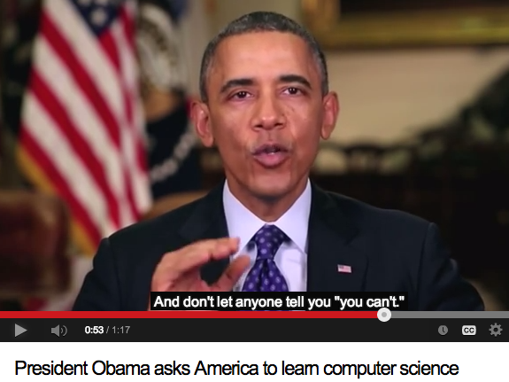
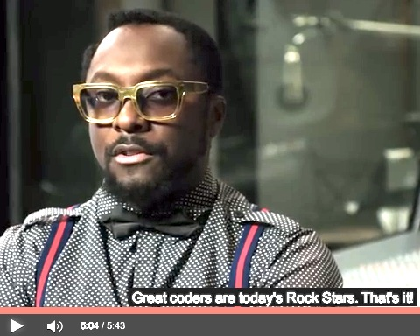
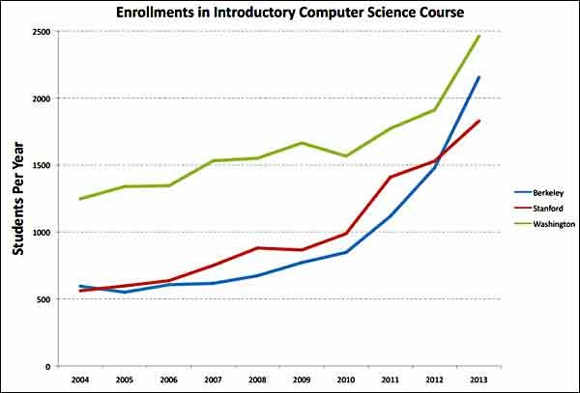
“Big Models”: More and more people writing and running more and more models
http://goo.gl/MJuxSt
http://goo.gl/ljFtX
Great coders are today’s
rock stars. --Will.i.am
2500
Washington
Stanford
Berkeley
500
2004
2009
2013

Slide 12
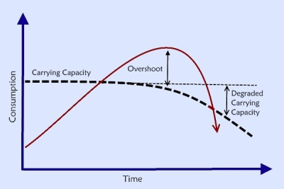
The CPU Crisis
You do the math.
What happens to a resource when
an exponentially increasing number of people ,
make exponentially increasing demands upon it?

Slide 13
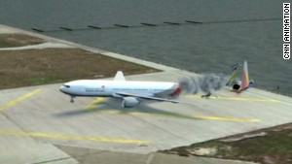
“Big Models” and the CPU crisis: Example #1
Cognitive models of the agents (both pilots and computers)
Late descent,
Unpredicted rerouting,
Different tailwind conditions
Goal: validate operations procedures (are they safe?)
NASA’s analysts want to explore 7000 scenarios.
With current tools (NSGA-II)
300 weeks to complete
Limited access to hardware
Queue of researchers wanting hardware access
Hardware pulled away if in-flight incidents for manned space missions
Asiana Airlines
Flight 214

Slide 14

“Big Models” and the CPU crisis: Example #2
• Very rapid agile software development
• Continually retesting all code
• 4 billion unit tests Jan to Oct 2013
• Welcome to the resource economy.
[Stokely et al. 2009]

Slide 15
Search-based SE (SBSE)
﻿Many SE activities are like optimization problems [Harman,Jones’01].
Due to computational complexity, exact optimization methods can be impractical for large SBSE problems
So researchers and practitioners use metaheuristic search to find near optimal or good-enough solutions.
E.g. simulated annealing [Rosenbluth et al.’53]
E.g. genetic algorithms [Goldberg’79]
E.g. tabu search [Glover86]

Slide 16
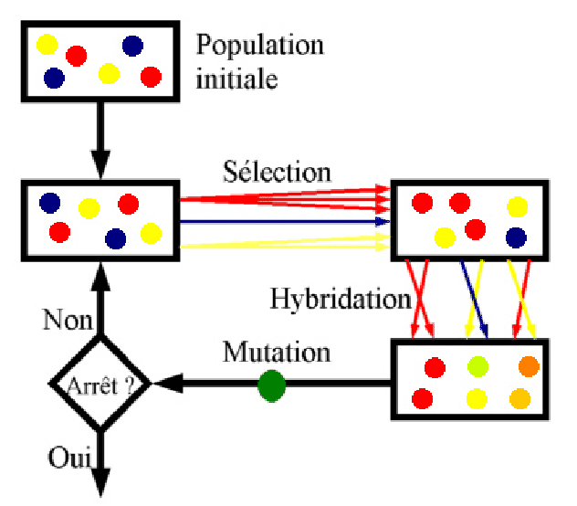
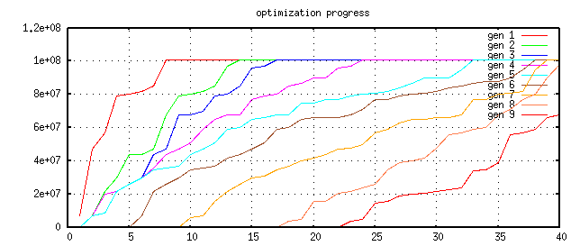
Pareto optimality and evolutionary computing
Repeat till happy or exhausted
Selection (cull the herd)
Cross-over (the rude bit)
Mutation (stochastic jiggle)
Pareto frontier
-- better on some criteria, worse on none
Selection:
-- generation[i+1] comes from Pareto frontier of generation[i]
9
8
7
6
5
4
3
2
1

Slide 17
Applications of SBSE
1. Requirements Menzies, Feather, Bagnall, Mansouri, Zhang
2. Transformation Cooper, Ryan, Schielke, Subramanian, Fatiregun, Williams
3.Effort prediction Aguilar-Ruiz, Burgess, Dolado, Lefley, Shepperd
4. Management Alba, Antoniol, Chicano, Di Pentam Greer, Ruhe
5. Heap allocation Cohen, Kooi, Srisa-an
6. Regression test Li, Yoo, Elbaum, Rothermel, Walcott, Soffa, Kampfhamer
7. SOA Canfora, Di Penta, Esposito, Villani
8. Refactoring Antoniol, Briand, Cinneide, O’Keeffe, Merlo, Seng, Tratt
9. Test Generation Alba, Binkley, Bottaci, Briand, Chicano, Clark, Cohen, Gutjahr, Harrold, Holcombe, Jones, Korel, Pargass, Reformat, Roper, McMinn, Michael, Sthamer, Tracy, Tonella,Xanthakis, Xiao, Wegener, Wilkins
10. Maintenance Antoniol, Lutz, Di Penta, Madhavi, Mancoridis, Mitchell, Swift
11. Model checking Alba, Chicano, Godefroid
12. Probing Cohen, Elbaum
13. UIOs Derderian, Guo, Hierons
14. Comprehension Gold, Li, Mahdavi
15. Protocols Alba, Clark, Jacob, Troya
16. Component sel Baker, Skaliotis, Steinhofel, Yoo
17. Agent Oriented Haas, Peysakhov, Sinclair, Shami, Mancoridis

Slide 18
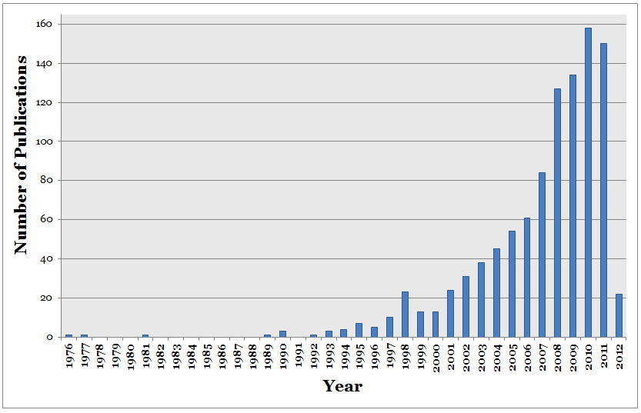
Explosive growth in SBSE
Q: Why?
A: Thanks to Big Data, more access to more cpu.

Slide 19
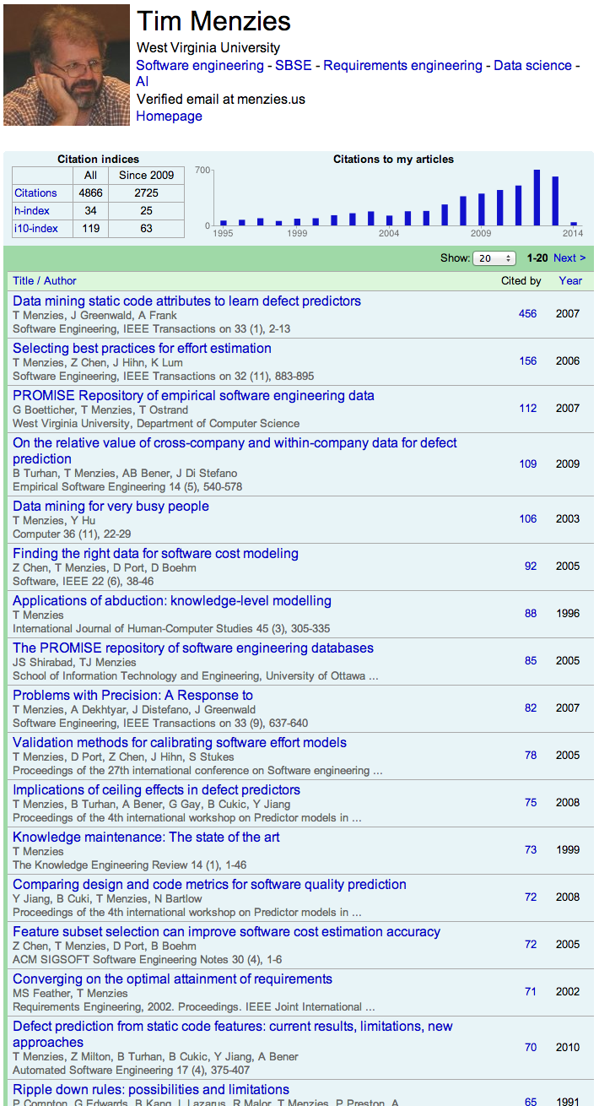

“one of the earliest applications of Pareto optimality in search-based software engineering (SBSE) for requirements engineering.” -- Mark Harman, UCL
2002

Slide 20
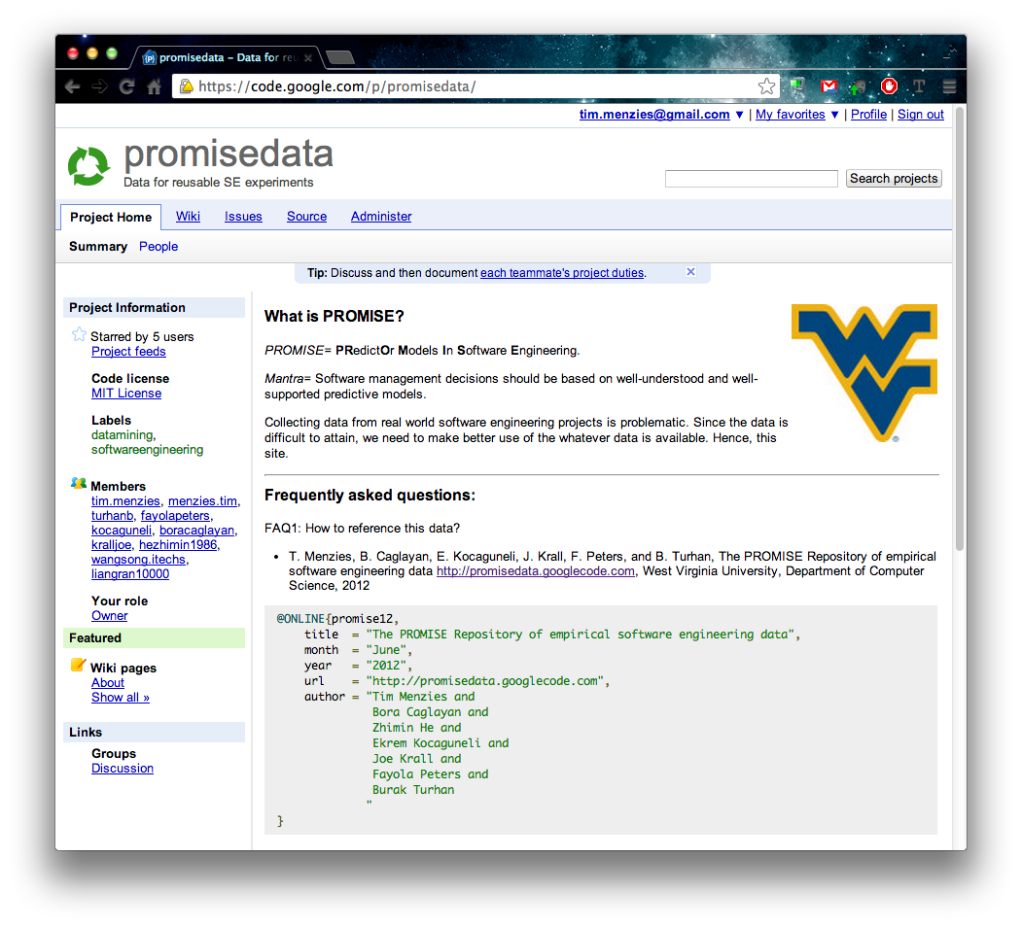
2007
2004 - now
2009
“one of the earliest applications of Pareto optimality in search-based software engineering (SBSE) for requirements engineering.” -- Mark Harman, UCL
2002

Slide 21
Why build more tools for SBSE and goal-oriented RE?
(Aren’t there enough already?)

Slide 22
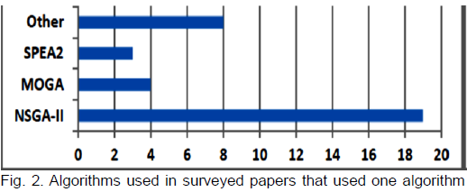
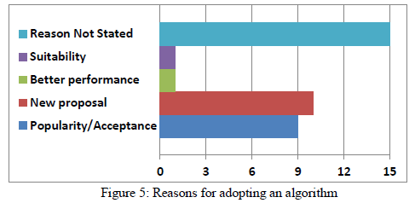
Do we need more SBSE tools for goal-based RE?
PSO
IBEA
DE
Scatter
search
Spea2
GALE
Nsga-II
SA
mocell
Z3
SMT solvers

Slide 23
Case study: Feature maps ➔ products
Design product line [Kang’90]
Add in known constraints
E.g. “if we use a camera then we need a high resolution screen”.
Extract products
Find subsets of the product lines that satisfy constraints.
If no constraints, linear time
Otherwise, can defeat state-of-the-art optimizers [Pohl et at, ASE’11] [Sayyad, Menzies ICSE’13].
Cross-Tree
Constraints

Slide 24
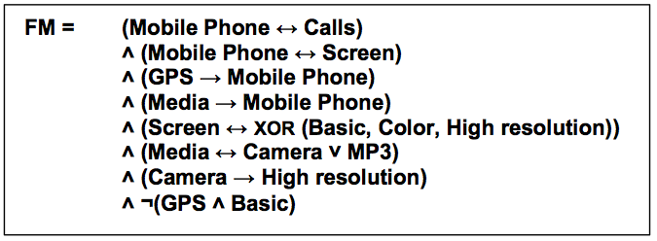
Size of feature maps
This model: 10 features, 8 rules
[www.splot-research.org]: ESHOP: 290 Features, 421 Rules
LINUX kernel variability project
LINUX x86 kernel
6,888 Features; 344,000 Rules
Cross-Tree Constraints

Slide 25
4 studies: 2 or 3 or 4 or 5 goals
Software engineering = navigating the user goals:
Satisfy the most domain constraints (0 ≤ #violations ≤ 100%)
Offers most features
Build “stuff” In least time
That we have used most before
Using features with least known defects
Binary goals= 1,2
Tri-goals= 1,2,3
Quad-goals= 1,2,3,4
Five-goals= 1,2,3,4,5

Slide 26
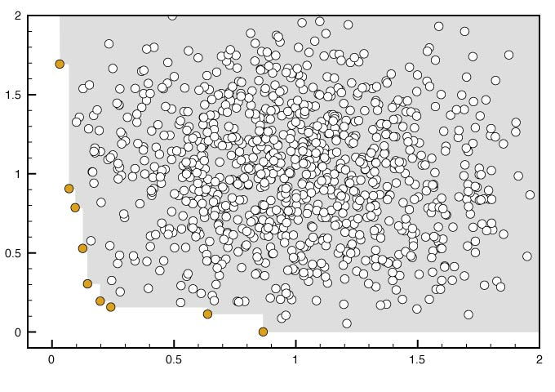
HV = hypervolume of dominated region Spread = coverage of frontier % correct = %constraints satisfied
Example performance criteria
Example in bi-goal space Note: example on next slide reports HV, spread for bi, tri, quad, five objective space
Abdel Salam Sayyad, Tim Menzies, Hany Ammar: On the value of user preferences in search-based software engineering: a case study in software product lines. ICSE 2013: 492-501

Slide 27
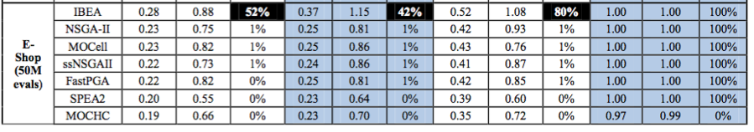
HV = hypervolume of dominated region Spread = coverage of frontier % correct = %constraints satisfied
ESHOP: 290 features, 421 rules [Sayyad, Menzies ICSE’13]
Continuous
dominance
Binary
dominance
Very different, particularly in % correct
Very similar
Abdel Salam Sayyad, Tim Menzies, Hany Ammar: On the value of user preferences in search-based software engineering: a case study in software product lines. ICSE 2013: 492-501

Slide 28
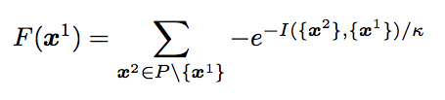
Q: What is so different about IBEA? A: Continuous dominance
[Wagner et.al. 2007]
Discrete
Continuous
Two sets of decisions
One dominates the other if worse on none and better on at least one
Note: returns true false
Neglects to report the size of the domination
IBEA : [Zitzler, Kunzli, 2004]
I(x¹,x²):
How much do we have to adjust goal scores such that x¹ dominates x²
Repeat till just a few left
re each instance x¹ buy summing its “I”
Sort all instances by F
Delete worst
Then, standard GA (cross-over, mutation) on the survivors
time to 100 mph
K= 0.05
heaven
Cost of car

Slide 29
What are the added benefits of goal-oriented reasoning?
Case study: Feature maps for product-line engineering

Slide 30
State of the Art
Features
300,000+
clauses
6888
Single-goal
Multi-goal
Johansen ‘11
Henard ‘12
Sayyad, Menzies’13b
Linux (LVAT)
White ‘07, ‘08, 09a, 09b,
Shi ‘10, Guo ‘11
544
290
Pohl ‘11
Lopez-Herrejon ‘11
Sayyad,
Menzies’13a
Velazco ‘13
SPLOT
Benavides ‘05
9
Objectives

Slide 31
The Seeding Heuristic
Given M < N goals that are hardest to solve
Before running an N-optimization problem:
Seed an initial population by via M-optimization
Study1 (with Z3) :
Optimize for min constraint violations using Z3
Study2 (with IBEA):
Optimize for (a) max features and (b) min violations

Slide 32
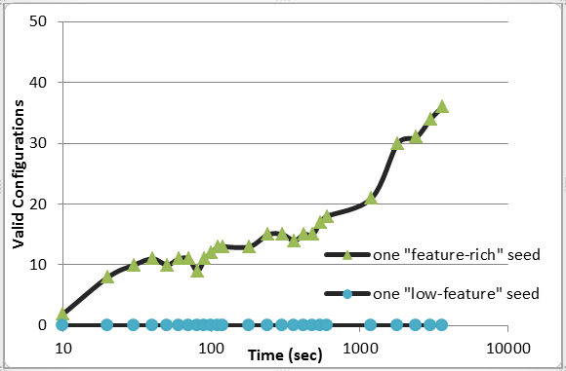
Correct solutions after 30 minutes for the large Linux Kernel model
5704 of
6888
features
From IBEA
130 of
6888
features
From Z3
Abdel Salam Sayyad Joseph Ingram Tim Menzies Hany Ammar,
Scalable Product Line Configuration: A Straw to Break the Camel’s Back , IEEE ASE 2013

Slide 33
How to make goal-based reasoning faster? (GALE= Geometric Active LEarning)
Case study: Safety critical analysis of aviation procedures

Slide 34
WMC: GIT’s Work Models that Compute [Kim’11]
Cognitive models of the agents (both pilots and computers)
Late descent,
Unpredicted rerouting,
Different tailwind conditions
Goal: validate operations procedures (are they safe?)
NASA’s analysts want to explore 7000 scenarios.
With current tools (NSGA-II)
300 weeks to complete
Limited access to hardware
Queue of researchers wanting hardware access
Hardware pulled away if in-flight incidents for manned space missions
Asiana Airlines
Flight 214

Slide 35
Active learning and evolutionary computing
Repeat till happy or exhausted
Selection (cull the herd)
Cross-over (the rude bit)
Mutation (stochastic jiggle)
Naïve selection
• score every candidate Active learning • Score only the most informative candidates • e.g. just score most distant points in data
clusters

Slide 36
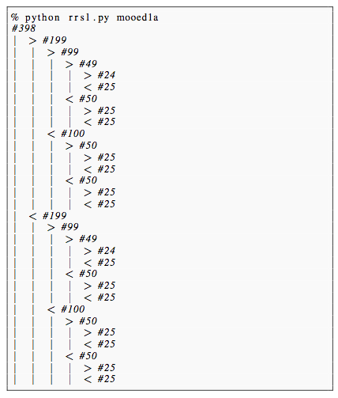
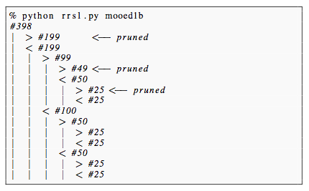
Recursively cluster data, find most distant points in leaf clusters
e.g. 398 cars
Maximize acceleration,
Maximize mpg
Find splits using FASTMAP O(n) [Faloutsos & Lin ’95]
At each level only check for dominance of two most extreme points
2log₂(N) evals, or less
Leaves = non-dominated examples (i.e. the Pareto frontier)
14 evaluations
of goals

Slide 37
For frontier as convex hull, for each line segment, push towards best end
• utopia
Given goals u, v, …
utopia = best values
hell = furthest from utopia
All distances normalized 0..1
Given a line east to west
s1 = I(east, hell)
s2 = I(west, hell), s2 > s1
C = dist(west,east)
p = push on line east,west
direction = towards better (west)
magnitude[i]=
D= west[i] – east[i]
new = old + old * C * D
Reject if over C*1.5
v
east
s1
west
s2
hell •
u
v
p
hell •
u
v
hell •
u

Slide 38
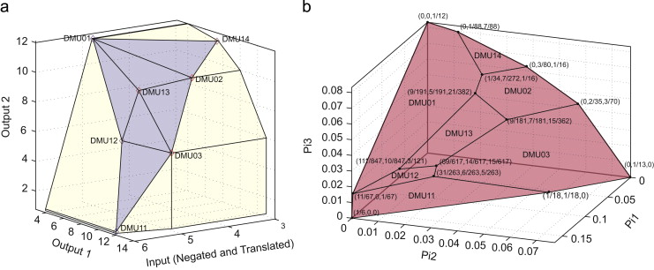
Repeat for all points on line segments on non-dominated region of convex hull
GALE:
Population[ 0 ] = N random points
Find M points on local Pareto frontier (approximated as convex hull)
Mutants = mutate M over line segments on hull
Population[ i+1 ] = Mutants + (N – #Mutants) random points
Goto 2
Related work: [Zuluaga et al. ICML’13]

Slide 39
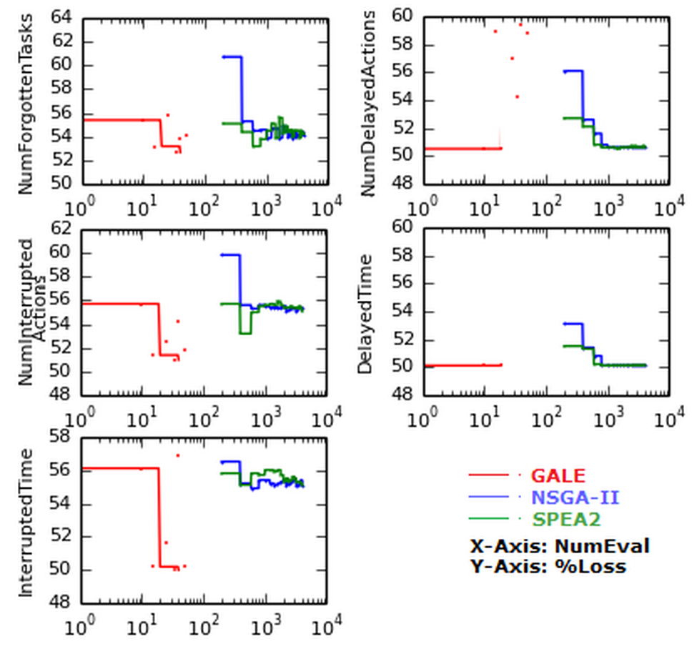
Results on NASA models: Scores as good as other methods Orders of magnitude fewer evaluations
Cognitive models of
Pilots
4 mins (GALE) vs 7 hours (rest)
#forgotten tasks
#interrupted acts
Interruption time
1
4
#delayed acts
Delay time
1
4
2
5
3
2
5
3

Slide 40
Number of evaluations
The usual suspects
Schaffer
Srinivas
Viennet 2
Tanaka
Osyczka2
ZDT1
Golinksi
…
[Port, Menzies, Ase’08] POM3abcd

Slide 41
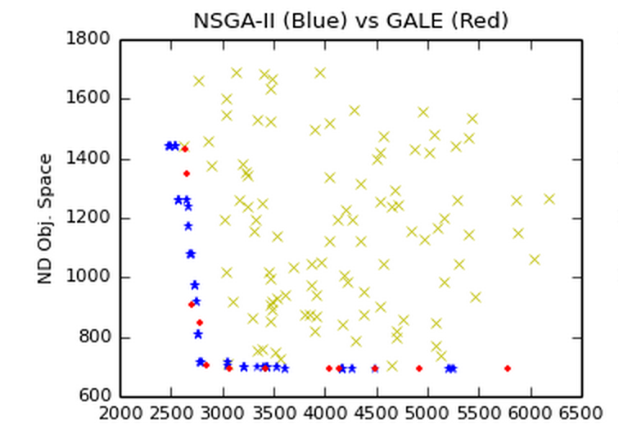
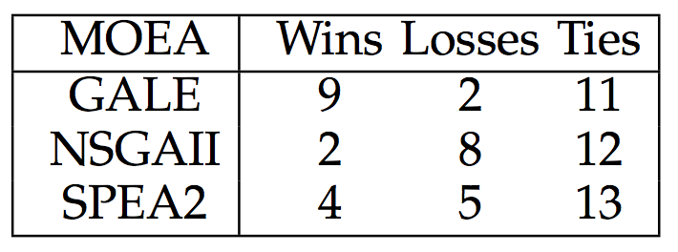
Results on other models
Sample Spreads
Change in objective scores
Compare initial population to final frontier
Mann-Whitney, 95% confidence

Slide 42
Conclusion

Slide 43
The CPU Crisis
You do the math.
What happens to a resource when
an exponentially increasing number of people ,
make exponentially increasing demands apon it?

Slide 44
Q: In the age of Big Data, what role for Software Engineers? A: Goal Engineering
Search-based software engineering
CPU-intensive analysis
Taming the CPU crisis by understanding user goals
Algorithms needs goal-oriented requirements engineering
Goals are a primary design construct
To optimize, find the “landscape of the goals”
Goal-oriented requirements engineering need algorithms
Better tools for better explorations of user goals

Slide 45
To manage the CPU crisis: need a better understanding of the “shape” of the user goals
Domination
Is a binary
concept
PSO
IBEA
Aggressive
exploration
of preference
space
DE
Scatter
search
GALE
Spea2
TAR
Nsga-II
SA
WHICH
mocell
Z3
SMT solvers

Slide 46
Combining algorithms and goal-oriented RE
Edsger Dijkstra, ICSE 4, 1979
Tim Menzies, 2014
“The notion of ‘user’ cannot be precisely defined, and therefore has no place in CS or SE.”
Mathematical definition of “user”
“The force that changes the geometry of search space.”

Slide 47
Future Work

Slide 48

GALE
More models: Taming the Big Data CPU crisis in software engineering (via active learning)
Parallel
Collapsing correlated goals
Other:
GALE approximates a population as a small set of linear models
• Compression?
• Anomaly detection?
• Privacy ?!!!!

Slide 49
After “Big Data”, “Big Models” ?
“Big Data”
“Big Models”
2003:
growing interest
2004:
Begin PROMISE project
SE + data mining
Collect data sets
Repeatable SE case studies
2013:
Data is routinely mined,
standard tool in many research papers
lots of commercial interest
2013:
growing interest
2014:
Start of PLAISE project
SE + (planning, learning, AI)
Collect models
Repeatable SE case studies
2023:
Big models are used routinely
standard tool in many research papers,
lots of commercial interest

Slide 50
In the age of Big Data, what role for Software Engineers?

Slide 51
SE in the age of Big Data
Analysis is a “systems” task?
Analysis is a “human” task?
The premise of Big Data:
better conclusions = same algorithms + more data + more cpu
If so, then …
No role for human analysts
All insight is auto-generated from CPUs.
Current results on “software analytics”
A human-intensive process

Slide 52
Analysis = humans + systems
better conclusions =
more data
more cpu
human analysts finding better questions
automatic systems that better understand the questions

Slide 53


